Slide 1



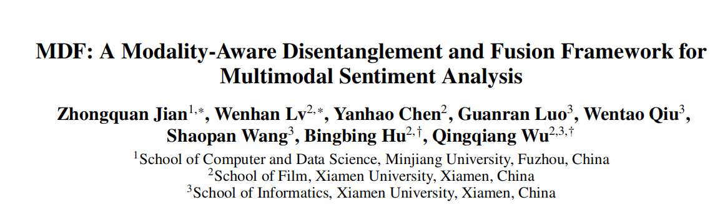





Chongqing University of Technology
ATAI
Advanced Technique of Artificial Intelligence
Chongqing University of Technology
Code：https://github.com/jian-projects/msa-mdf
—— AAAI 2026
Reported by ZhiWei Xu

Slide 2
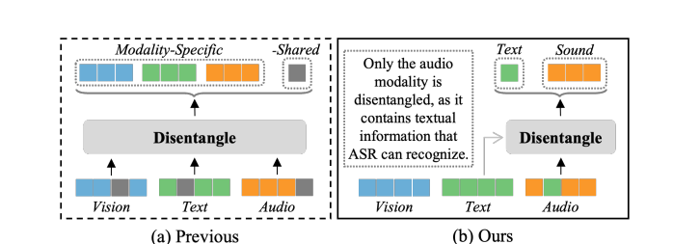
Motivation
(1)Despite their conceptual clarity and superior performance,the disentangled modality-invariant and modality-specificfeatures are abstract and lack interpretability, as they are understood by machines rather than humans.erefore, humans can intuitively understand and interpret the meanings of modality-specific features, while modality-invariant features remain abstract and impercepti-ble, limiting the potential of disentangle-based models.
(2) Traditional fusion methods and often treat all modalities equally, learning their interactions implicitly. However, recent studies reveal that modalities contribute unequally,However, strong cross-modal het
erogeneity, particularly between audio and visual modalities, makes it challenging to capture these correlations
accurately.

Slide 3
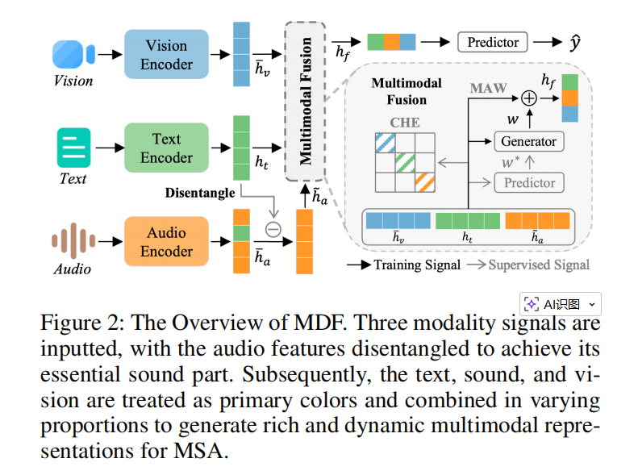
Method

Slide 4


Method

Slide 5

Method

Slide 6



Method

Slide 7
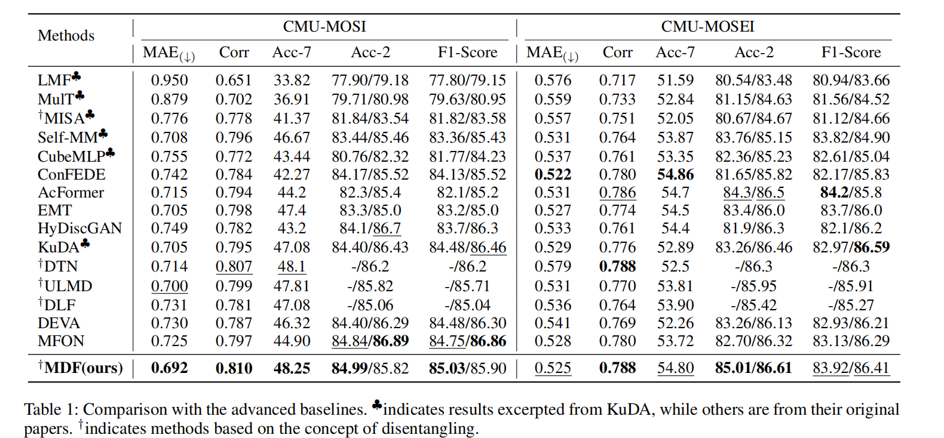
Experiments

Slide 8
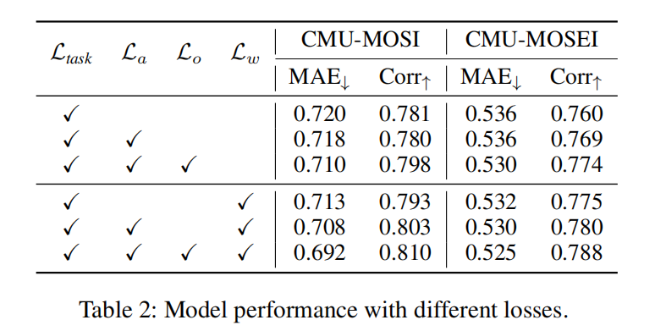
Experiments

Slide 9
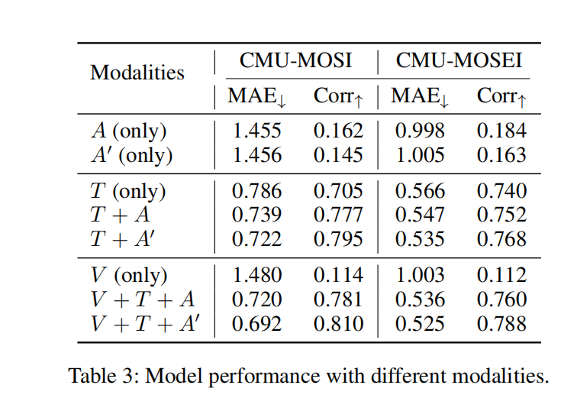
Experiments

Slide 10
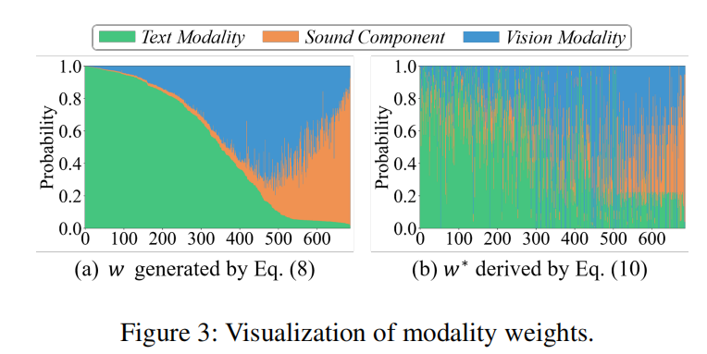
Experiments

Slide 11
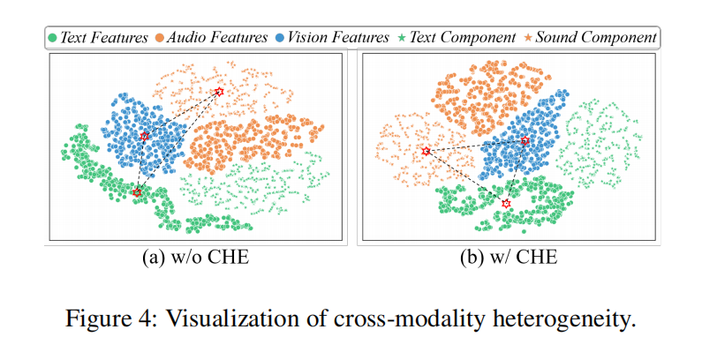
Experiments

Slide 12
Thanks!

